Slide 1
LINES

Slide 2
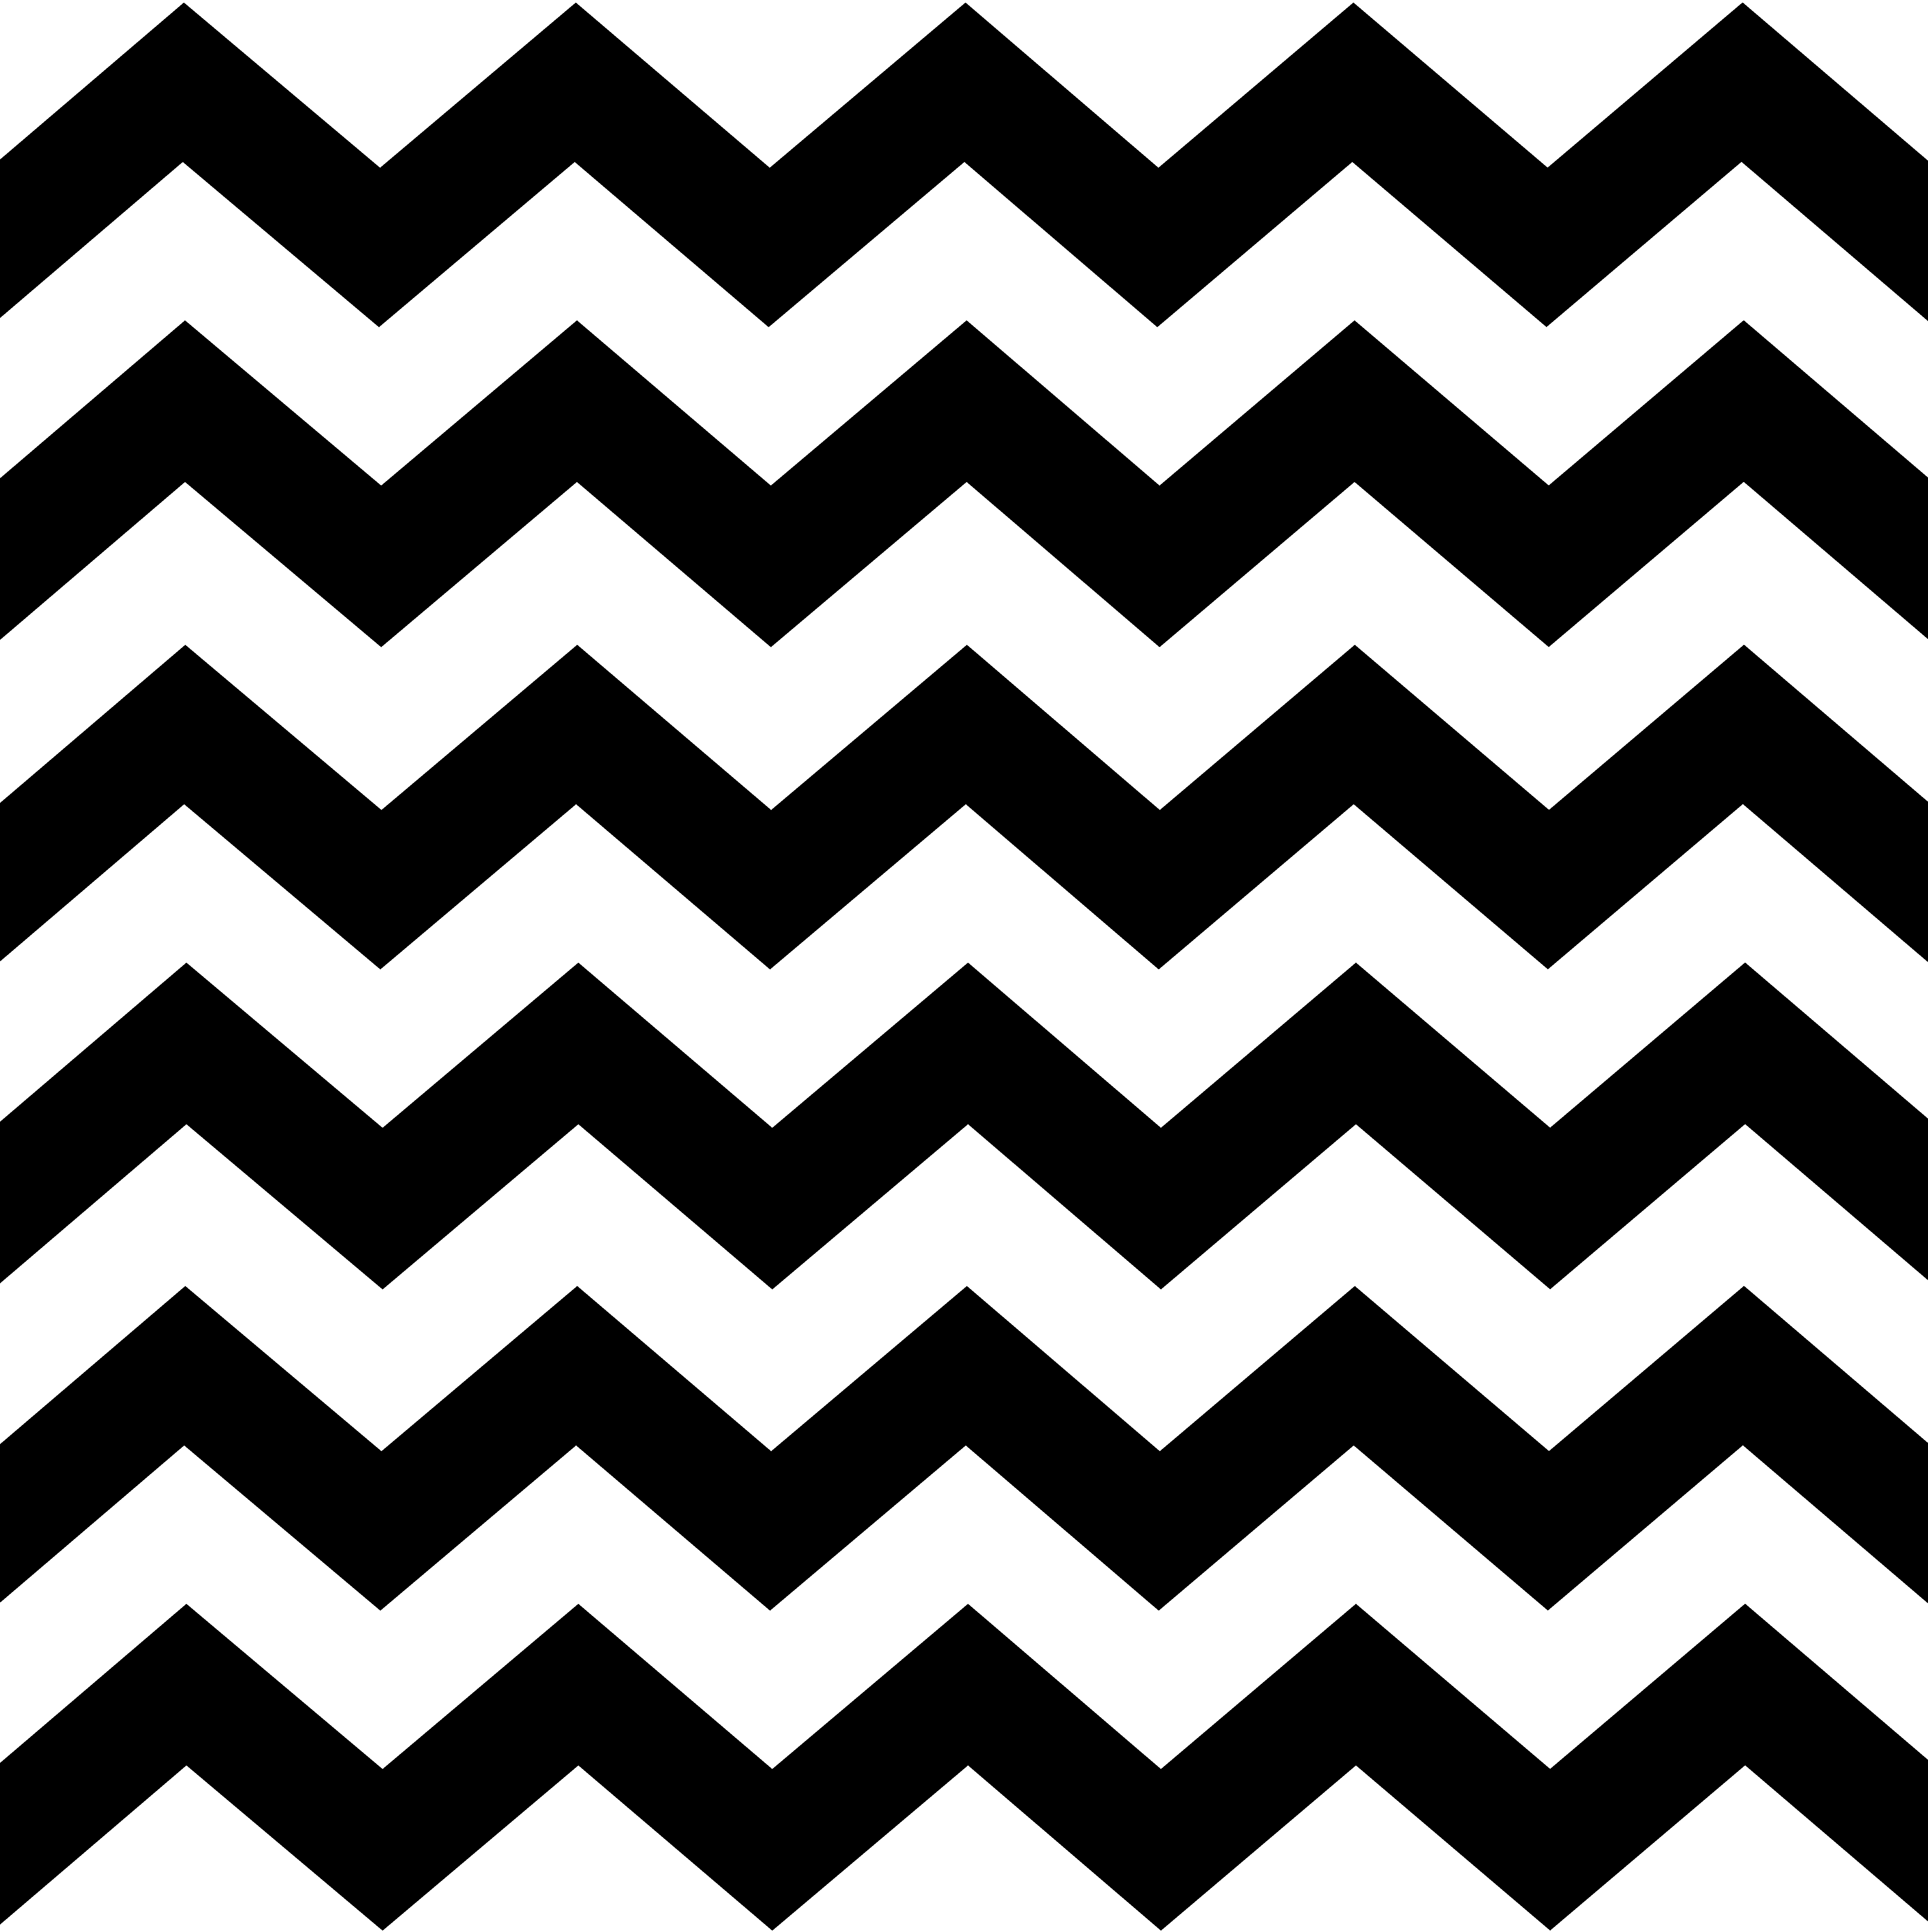
Diagonal lines are slanted. They make things feel active.

Slide 3
Line is an element of art defined by a point moving in space.

Slide 4
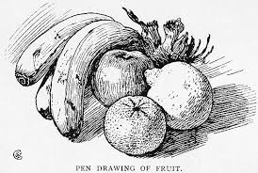
Some ways an artists can use line is to draw pictures, create pattern, make an outline, give the idea of mood. Can you think of other ways an artist might use lines?

Slide 5
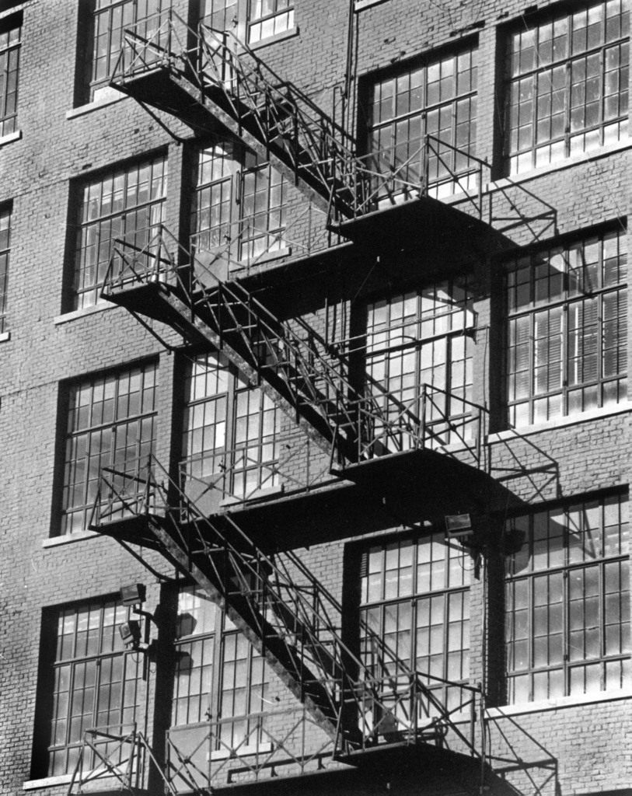
Diagonal Line

Slide 6
Vertical

Slide 7
Horizontal

Slide 8
Thick

Slide 9
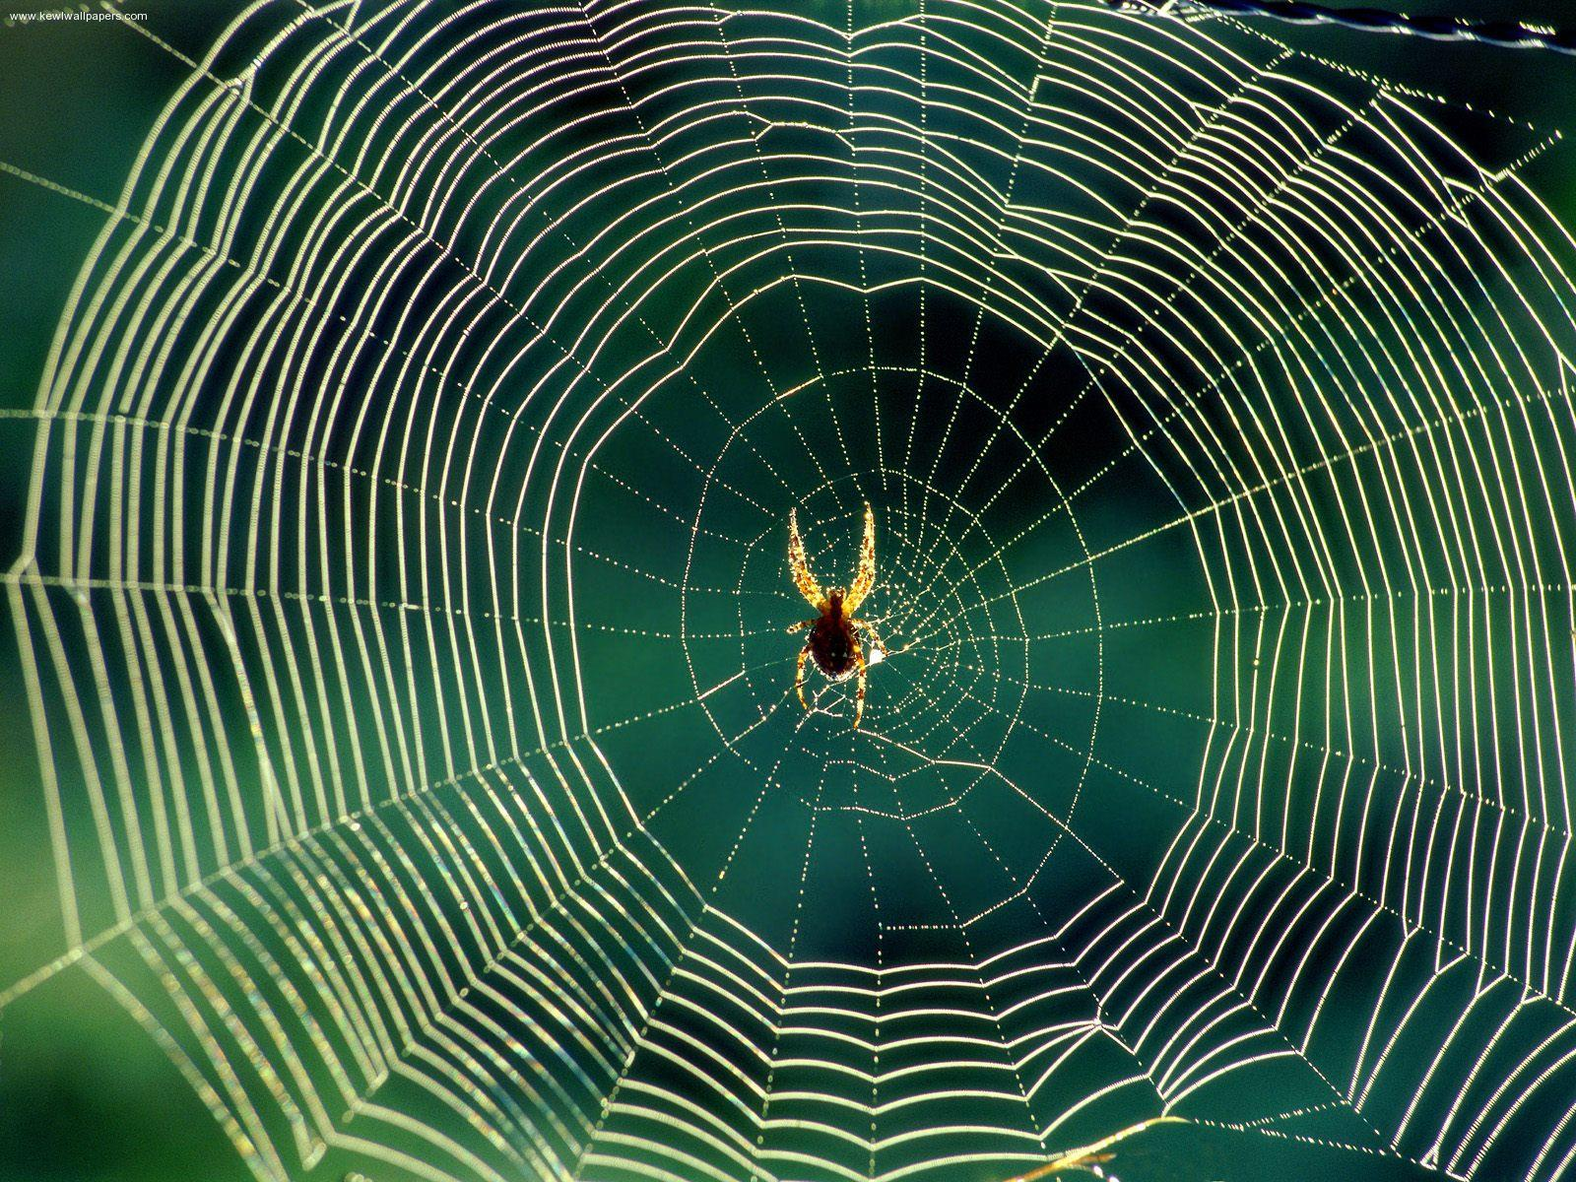
Thin

Slide 10
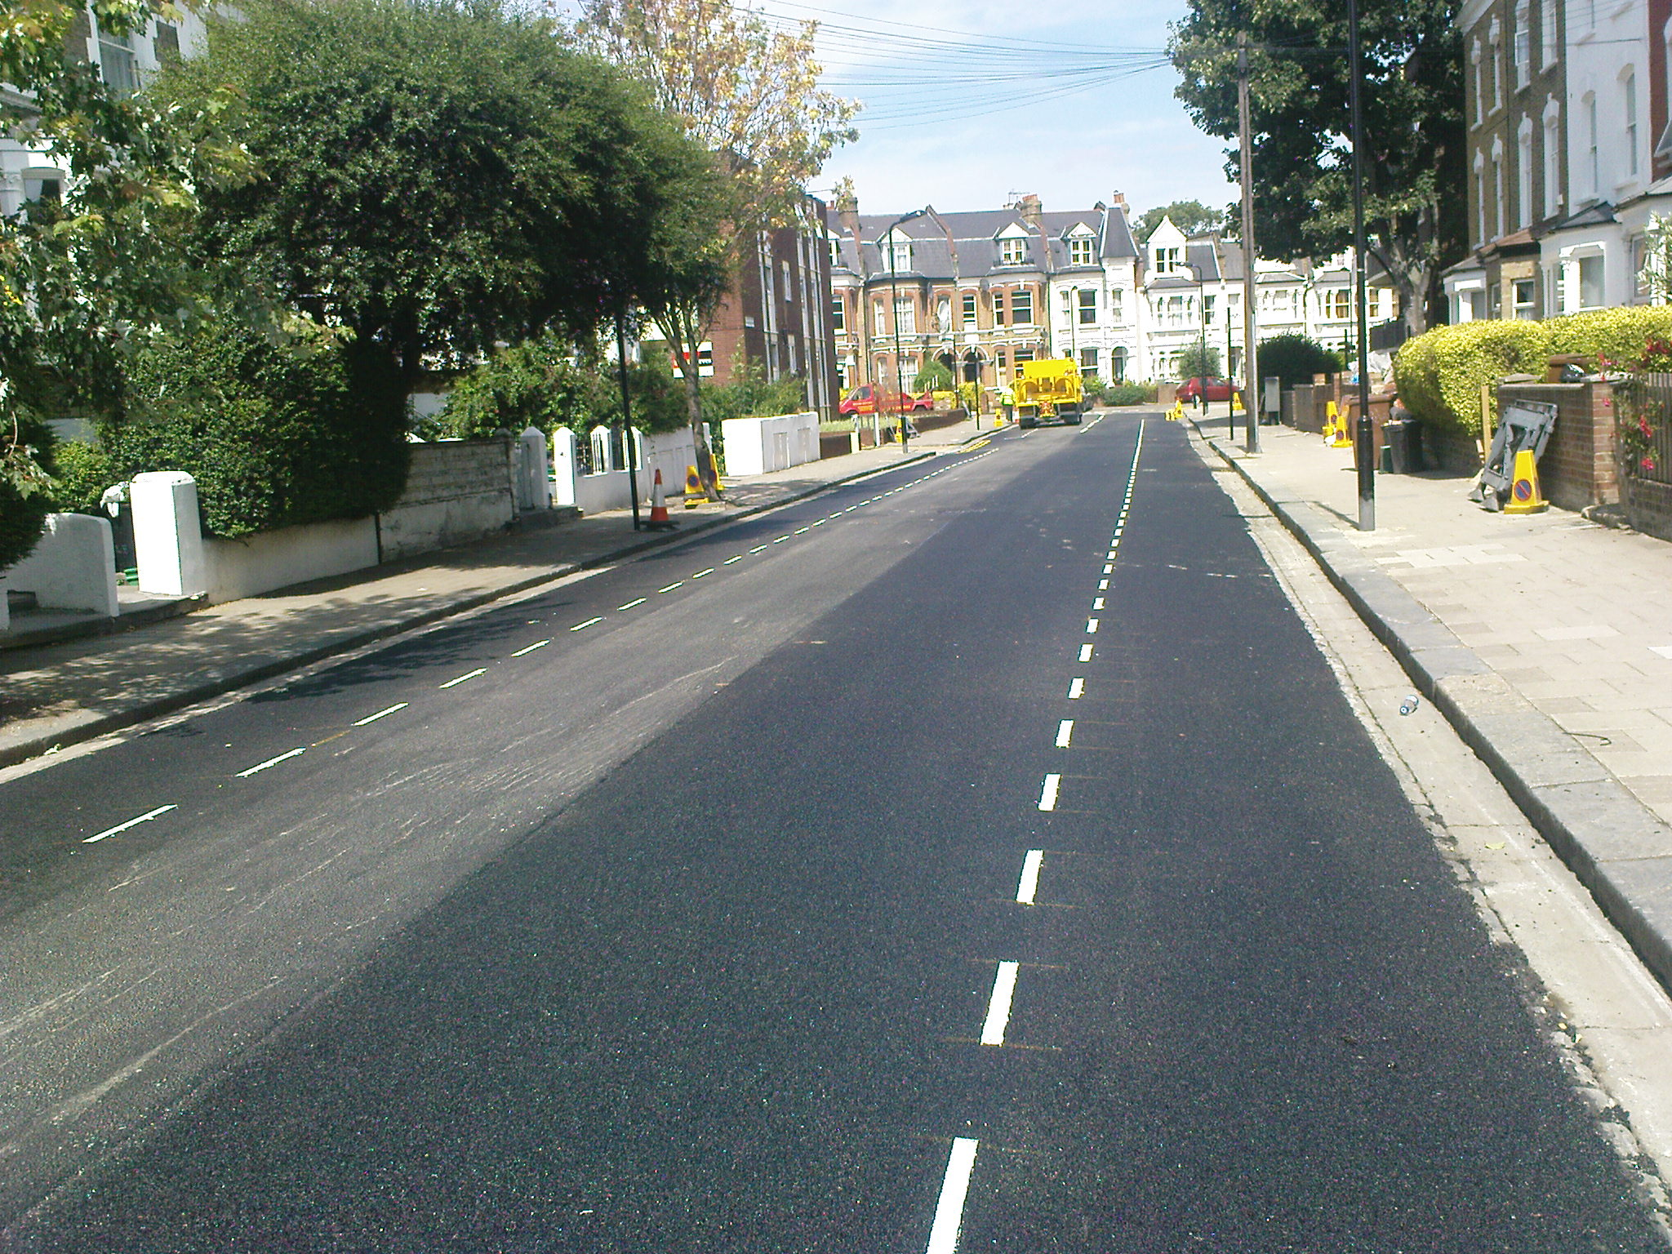
Broken

Slide 11
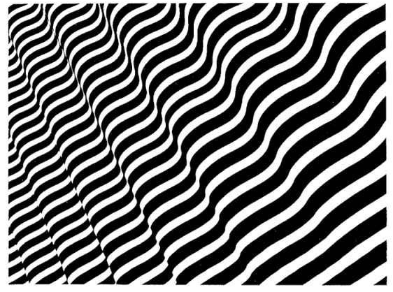
Wavy

Slide 12
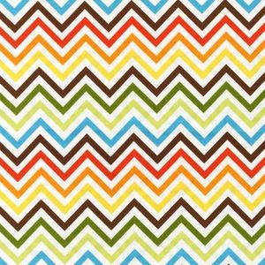
Zigzag

Slide 13
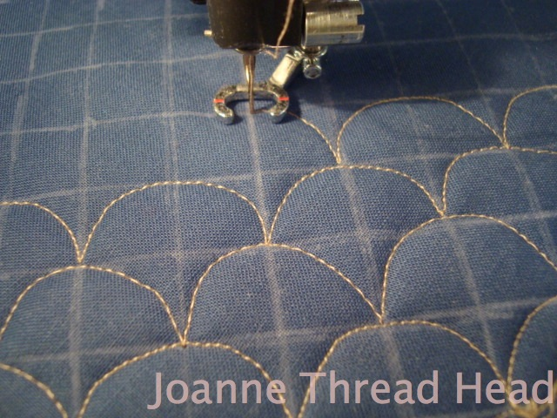
Bumpy

Slide 14
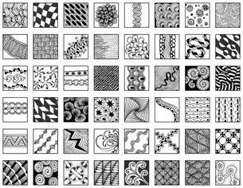
Lines can be used to make patterns.

Slide 15
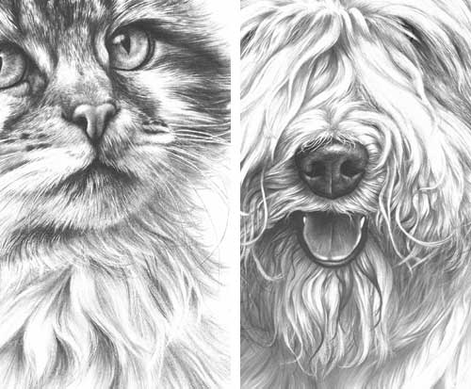
Lines can be used to show texture.

Slide 16
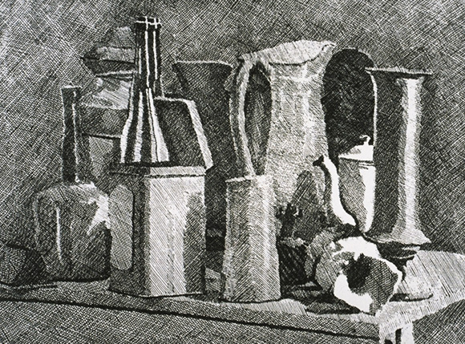
Line can be used to show value.

Slide 17
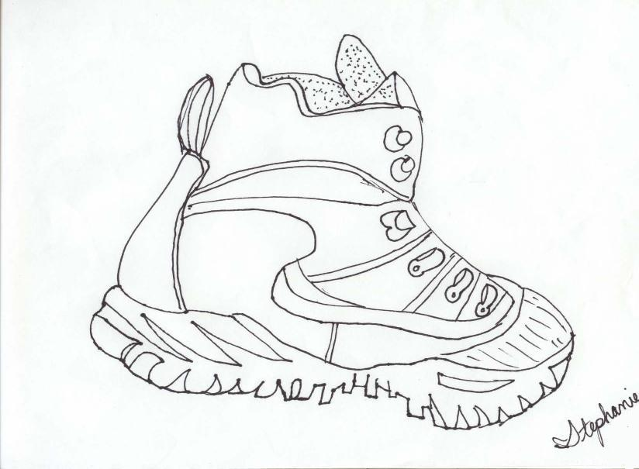
Lines can be used for outlining.

Slide 18
Lines can show moods.
Vertical Lines move straight up and down. They make things feel steady and calm.
Horizontal Lines move from side to side. The feel calm and peaceful.

Slide 19
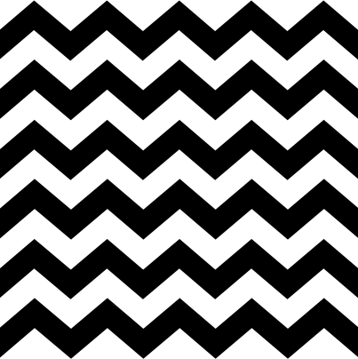
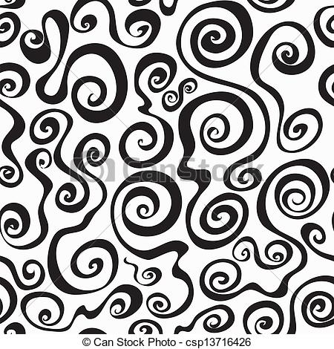
Zigzag lines are diagonal lines that connect. They give a feeling of excitement.
Diagonal lines are slanted. They make things feel active.
Curved lines bend and change directions slowly. They give a feeling of graceful movement.

Slide 20
Be creative using lines!

