Slide 1
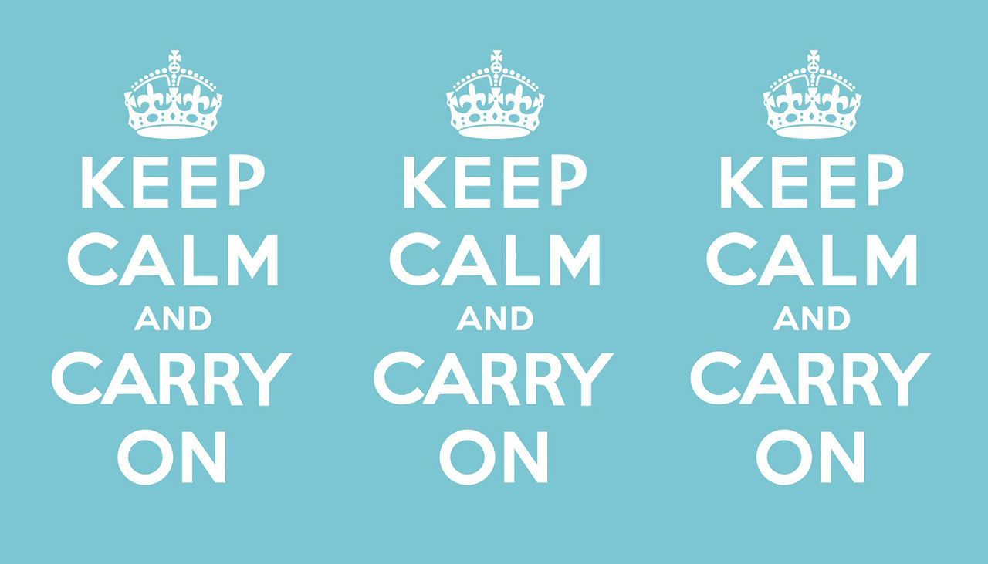

Slide 3
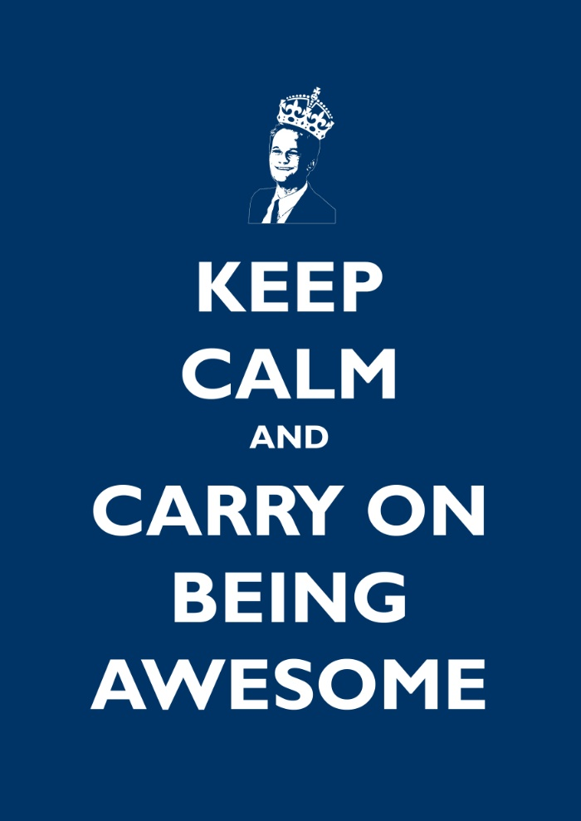
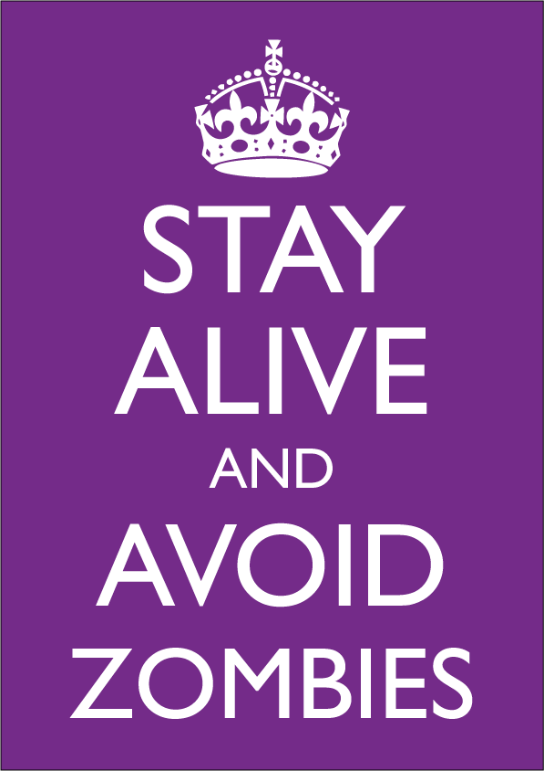

Slide 6
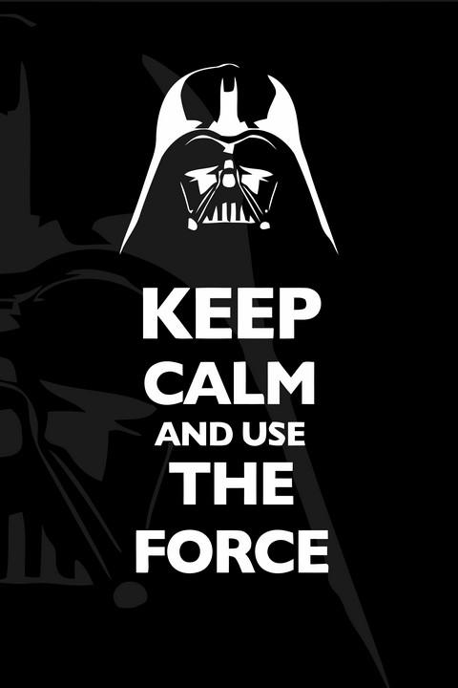

Slide 9
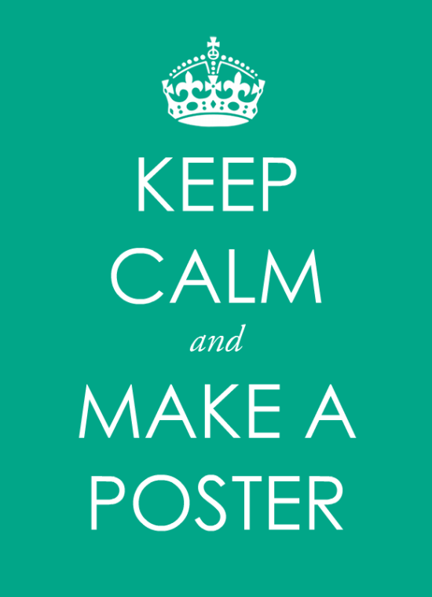
Think about what keeps you calm or gives you peace and design your own poster.
Start with a small picture at the top that will relate to your poster.
Then, add the lettering. Color it in and your done.

